Slide 2
Topics
Basic String Operations
String Slicing
Testing, Searching, and Manipulating Strings

Slide 3
Basic String Operations
Many types of programs perform operations on strings
In Python, many tools for examining and manipulating strings
  Strings are sequences, so many of the tools that work with sequences work with strings

Slide 4
Accessing the Individual Characters in a String
To access an individual character in a string:
  Use a for loop
    Format: for character in string:
    Useful when need to iterate over the whole string, such as to count the occurrences of a specific character
  Use indexing
    Each character has an index specifying its position in the string, starting at 0
    Format: character = my_string[i]

Slide 5
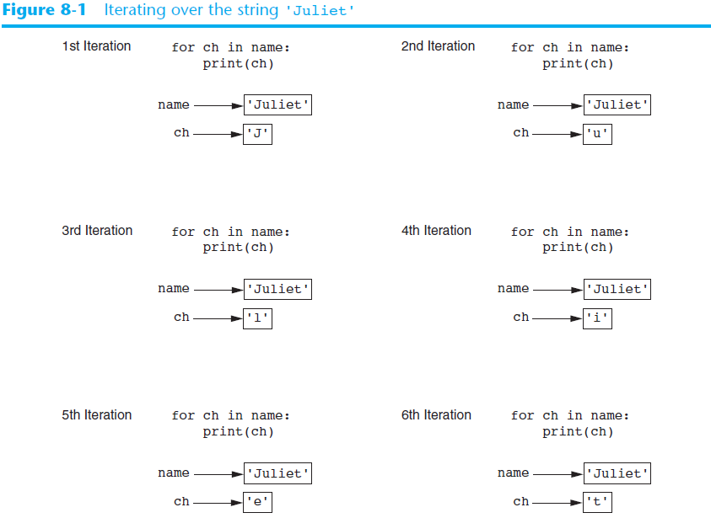

Slide 6
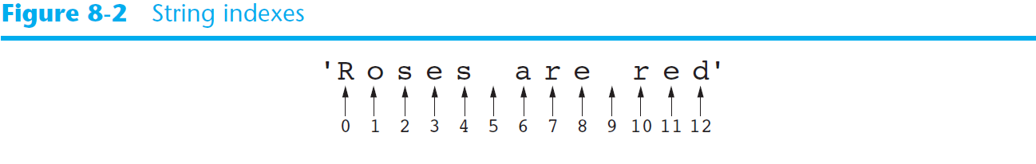
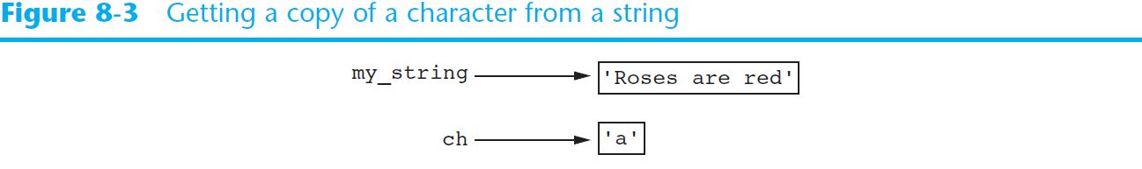
Accessing the Individual Characters in a String (cont’d.)

Slide 7
Accessing the Individual Characters in a String (cont’d.)
IndexError exception will occur if:
  You try to use an index that is out of range for the string
    Likely to happen when loop iterates beyond the end of the string
len(string) function can be used to obtain the length of a string
  Useful to prevent loops from iterating beyond the end of a string

Slide 8
String Concatenation
Concatenation: appending one string to the end of another string
  Use the + operator to produce a string that is a combination of its operands
  The augmented assignment operator += can also be used to concatenate strings
    The operand on the left side of the += operator must be an existing variable; otherwise, an exception is raised

Slide 9
Strings Are Immutable
Strings are immutable
  Once they are created, they cannot be changed
    Concatenation doesn’t actually change the existing string, but rather creates a new string and assigns the new string to the previously used variable
  Cannot use an expression of the form
  string[index] = new_character
    Statement of this type will raise an exception

Slide 10
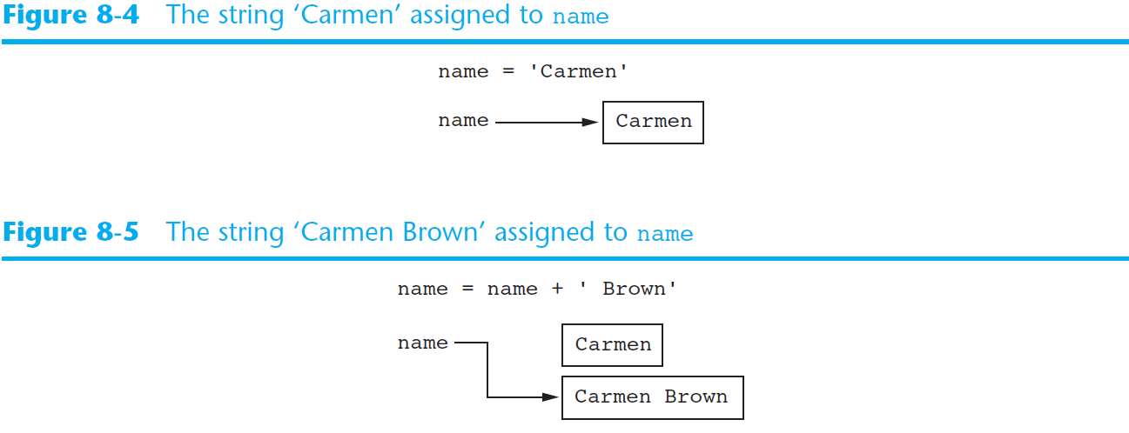
Strings Are Immutable (cont’d.)

Slide 11
String Slicing
Slice: span of items taken from a sequence, known as substring
  Slicing format: string[start : end]
    Expression will return a string containing a copy of the characters from start up to, but not including, end
    If start not specified, 0 is used for start index
    If end not specified, len(string) is used for end index
  Slicing expressions can include a step value and negative indexes relative to end of string

Slide 12
Testing, Searching, and Manipulating Strings
You can use the in operator to determine whether one string is contained in another string
  General format: string1 in string2
    string1 and string2 can be string literals or variables referencing strings
Similarly you can use the not in operator to determine whether one string is not contained in another string

Slide 13
String Methods
Strings in Python have many types of methods, divided into different types of operations
  General format: mystring.method(arguments)
Some methods test a string for specific characteristics
  Generally Boolean methods, that return True if a condition exists, and False otherwise

Slide 14
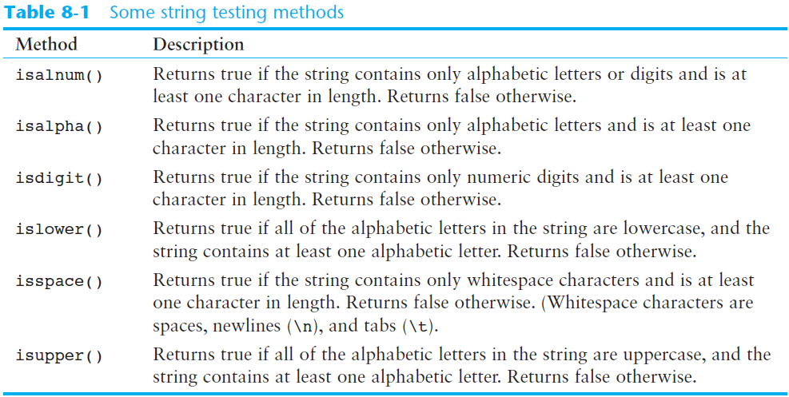
String Methods (cont’d.)

Slide 15
String Methods (cont’d.)
Some methods return a copy of the string, to which modifications have been made
  Simulate strings as mutable objects
String comparisons are case-sensitive
  Uppercase characters are distinguished from lowercase characters
  lower and upper methods can be used for making case-insensitive string comparisons

Slide 16
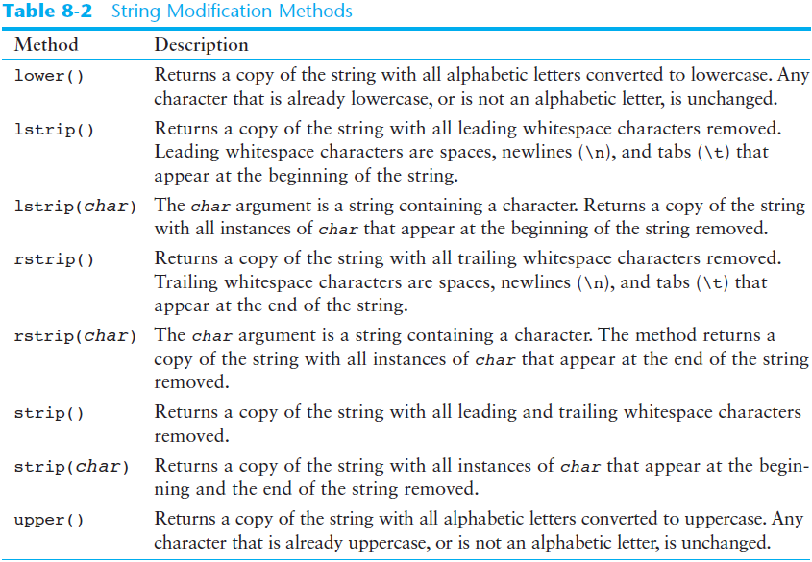
String Methods (cont’d.)

Slide 17
String Methods (cont’d.)
Programs commonly need to search for substrings
Several methods to accomplish this:
  endswith(substring): checks if the string ends with substring
    Returns True or False
  startswith(substring): checks if the string starts with substring
    Returns True or False

Slide 18
String Methods (cont’d.)
Several methods to accomplish this (cont’d):
  find(substring): searches for substring within the string
    Returns lowest index of the substring, or if the substring is not contained in the string, returns -1
  replace(substring, new_string):
    Returns a copy of the string where every occurrence of substring is replaced with new_string

Slide 19
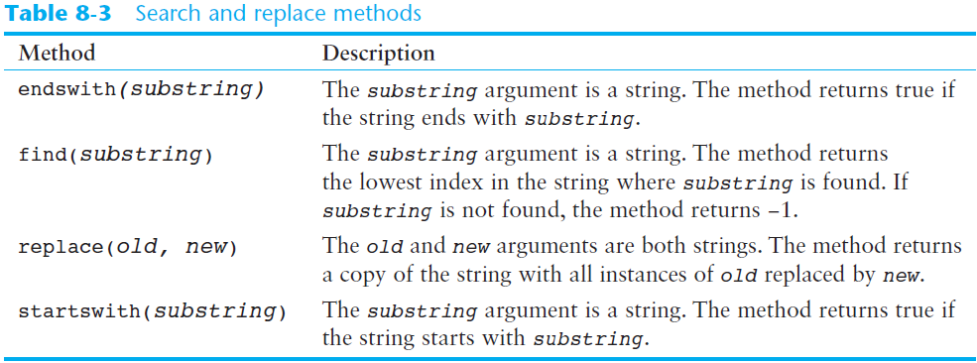
String Methods (cont’d.)

Slide 20
The Repetition Operator
Repetition operator: makes multiple copies of a string and joins them together
  The * symbol is a repetition operator when applied to a string and an integer
    String is left operand; number is right
  General format: string_to_copy * n
  Variable references a new string which contains multiple copies of the original string

Slide 21
Splitting a String
split method: returns a list containing the words in the string
  By default, uses space as separator
  Can specify a different separator by passing it as an argument to the split method

Slide 22
Splitting a String
Examples:
>>> my_string = 'One two three four'
>>> word_list = my_string.split()
>>> word_list
['One', 'two', 'three', 'four']
>>>
>>> my_string = '1/2/3/4/5'
>>> number_list = my_string.split('/')
>>> number_list
['1', '2', '3', '4', '5']
>>>

Slide 23
String Tokens
Sometimes a string contains substrings that are separated by a special character
  Example:
  This string contains the substrings peach, raspberry, strawberry, and vanilla
  The substrings are separated by the space character
  The substrings are known as tokens and the separating character is known as the delimiter
'peach raspberry strawberry vanilla'

Slide 24
String Tokens
Example:
  This string contains the tokens 17, 92, 81, 12, 46, and 5
  The delimiter is the ; character
'17;92;81;12;46;5'

Slide 25
String Tokens
Tokenizing is the process of breaking a string into tokens
When you tokenize a string, you extract the tokens and store them as individual items
In Python you can use the split method to tokenize a string

Slide 26
String Tokens
Examples:
>>> str = 'peach raspberry strawberry vanilla'
>>> tokens = str.split()
>>> tokens
['peach', 'raspberry', 'strawberry', 'vanilla']
>>>
>>> my_address = 'www.example.com'
>>> tokens = my_address.split('.')
>>> tokens
['www', 'example', 'com']
>>>

Slide 27
Summary
This chapter covered:
  String operations, including:
    Methods for iterating over strings
    Repetition and concatenation operators
    Strings as immutable objects
    Slicing strings and testing strings
    String methods
    Splitting a string

